Slide 1
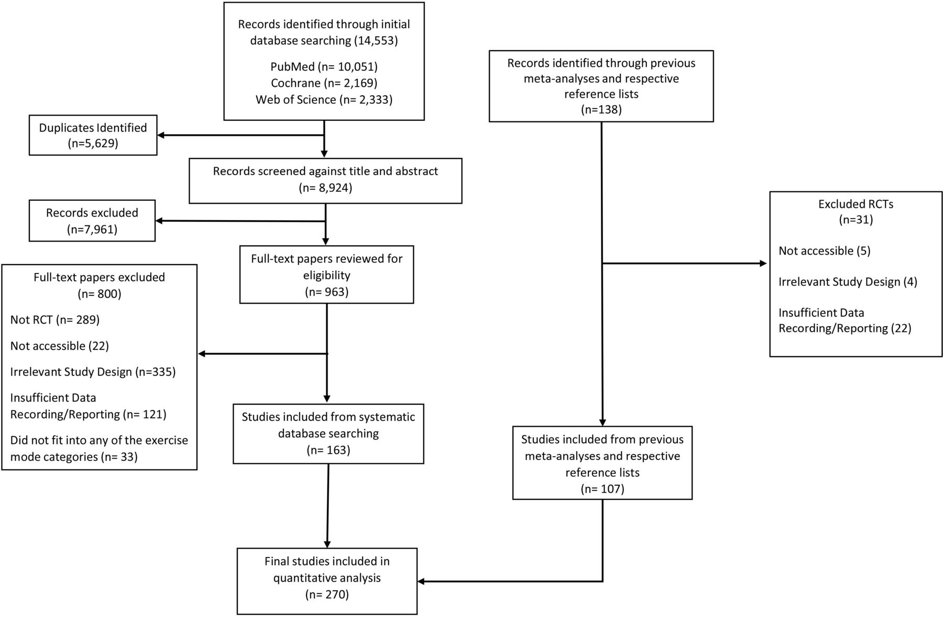

PRISMA systematic review and meta-analysis flow chart.
Jamie J Edwards et al. Br J Sports Med 2023;57:1317-1326
Copyright © BMJ Publishing Group Ltd & British Association of Sport and Exercise Medicine. All rights reserved.
Notes:
PRISMA systematic review and meta-analysis flow chart. RCT, randomised controlled trial.

